Slide 1


Context Matters: Innovative Approaches to Promoting and Measuring Equity-Oriented Healthcare in Primary Health Care Settings
Annette J. Browne, PhD, RN
Nadine Wathen, PhD, RN
Colleen Varcoe, PhD, RN
Marilyn Ford-Gilboe, PhD, RN
Bernie Pauly PhD, RN
Beth Jackson, PhD
Notes:
To set the context for today’s presentation, I’ll start by emphasizing that,
despite repeated calls to close the health equity gap, little attention has been paid to the complexity of implementing and measuring equity-oriented care in primary health care (PHC) settings.

Slide 2


Programmatic research on:
Impact of a Multi-Component, Organizational Intervention to Enhance Equity-Oriented Care in Primary Health Care Settings
https://equiphealthcare.ca/
Research Team Leads: Annette J. Browne, UBC
Colleen Varcoe, UBC
Marilyn Ford-Gilboe, Western University
Nadine Wathen, Western University
Notes:
In this presentation, I draw on new knowledge generated from “EQUIP Healthcare,” a program of research studying the effectiveness of a multi-component organizational intervention designed to enhance equity-oriented care for marginalized populations in four diverse PHC settings in Canada.
I focus specifically on the contextual factors that must be considered by, and with, practice and policy partners to effectively implement complex, tailored interventions within diverse settings.

Slide 3
Framework: Key Dimensions of Equity-Oriented PHC Services
Trauma- and Violence- Informed Care
Outcomes:
Contextually-Tailored Care
Culturally Safe Care
Shorter term:
increased effectiveness of services;
increased ‘fit’ between people’s needs and services;
increased access to resources;
increased capacity to manage health;
increased client activation
Harm Reduction
Inequity-Responsive Care
10 Strategies to Guide Organizations in Enhancing Capacity for Equity-Oriented Services
Explicit commitment to equity
Supportive structures, policies, and processes
Revision use of time
Attend to power differentials
Tailor care, programs and services to context
Actively counter oppression
Promote community + patient participatory engagement
Tailor care, programs and services to histories
Enhance access to social determinants of health
Optimize use of place and space
Longer term:
Improved Health and Quality of Life
Reduced Health Inequities at Population Level
Browne, A. J., et al. Closing the health equity gap: Evidence-based strategies for primary health care organizations. International Journal for Equity in Health, 11(59), doi: 10.1186/1475-9276-11-59
Notes:
Building on our framework identifying the key dimensions of equity-oriented PHC services and10 interrelated strategies, we designed, implemented and measured the effects of a complex intervention that could be both standardized and tailored to fit diverse organizational contexts.
Very briefly, the EQUIP intervention is underpinned by understandings of structural violence as continuous with patients’ experiences of trauma and violence, and positions cultural safety and harm reduction as essential to addressing both the causes and consequences of health inequities.

Slide 4

Browne, Varcoe, Ford-Gilboe, Wathen et al . 2015
Notes:
Details about the theory underlying the organization intervention has been published…

Slide 5

The EQUIP Intervention
Stage 1: Staff Education (~6 months)
    Orientation to Equity-Oriented PHC (2 hrs)
    Indigenous Cultural Safety + Countering Discrimination (8 hrs online + 2 hrs F2F)
    Trauma and Violence-Informed Care (8 hr workshop)
Stage 2: Organizational Integration and Tailoring of Specific Strategies to the Local Context (~6 months)
Practice Consultant Facilitator
Notes:
In a nutshell, The EQUIP intervention involved the use of a Practice Consultant who facilitated the implementation of staff education in three inter-related areas:
Health equity
Cultural safety including strategies for counteracting discrimination in hc contexts
And TVIC
AND in stage two, a process of Org Integ and Tailoring, which was led by the clinics and involved all levels of staff.

Slide 6
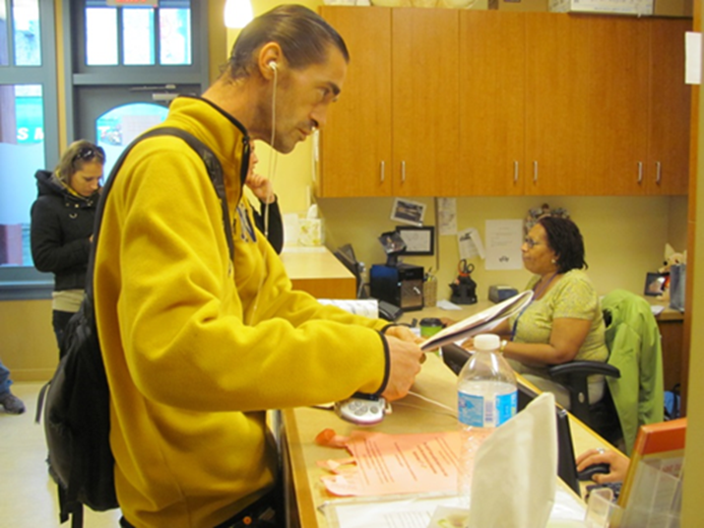
Evaluating Intervention Impacts:
Patient Interviews | Staff Surveys & Interviews
Participant Observation | Document Analysis
Structured Interviews with Patient Cohort (N = 567)
  4 times over 2.5 years
  Measures of Health Care Experiences and Health Status
Staff Survey (n=85)
  Baseline, 12 and 24 months later
Contextual and Policy Analysis:
  Organizational and Funding Policies
  Local, Regional and National Health Status Comparisons
Notes:
We have collected data from multiple sources – including from staff, patients and the organizational context - and are n the process of analyzing the data to fully understand the impacts of this multi-component intervention on patients, staff, and the organization.

Slide 7


Context Matters:
Solutions to Enable Equity-Oriented Care
Notes:
I’d now like to highlight several key strategies and actions that show particular promise in promoting equity-oriented care.
My aim is to emphasize practical and feasible ways for PHC organizations to enhance their equity-orientation in ways that can be tailored to their unique contexts.

Slide 8


Solution #1: A Complex Understanding of Health Equity is Required
“Lining up outside our clinic”
“Dismissing patients over the phone”
Receptionist’s Insights:
This is “structural violence!”
Notes:
One of the most significant insights from EQUIP is the extent to which ongoing dialogues are key to converting abstract ideas about health equity into meaningful, concrete practice, organizational and policy actions.
These ongoing dialogues, for example, led the receptionists at the clinics to identify that their policy of having patients wait outside the clinic before opening hours, and their manner of speaking to patients on the phone, were examples of structural violence that were continuous with the other forms of dismissal that patients routinely experienced in their everyday lives.
Importantly, this caused the receptionists and their respective orgs to institute immediate, easily implementable changes to their organizations’ processes which enhanced patients’ experiences of care.
In another site, to draw on an other example, engagement with the EQUIP intervention sparked a remarkable shift in the discourses, language, and tone used by all levels of staff during clinical case conferencing to more explicitly take into account the historical traumas experienced by patients, and to contextualize the clinical management of patients to take into account the structural inequities shaping their health and well being.
This was particularly relevant since 75% of their patient population identified as Indigenous.

Slide 9
Solution #2. Allow for Disruptive Innovations
Be prepared to manage tensions that will surface
Notes:
Because health equity necessitates discussions about structural violence, power inequities, and strategies to mitigate the health impacts of systemic racism, attention to these processes will surface tensions within the organization, and in relation to the organizaitons’ role in the broader health system context.
In EQUIP, for example, staff at some of the clinics departed because of realizing their lack of fit with the organizational values.
In other contexts, the process of engaging in EQUIP resulted in staff needing to readjust the inter-professional power dynamics that were preventing them from catalyzing the equity-oriented changes they had decided to focus on.
So, there is a need to manage changes, and to perhaps consider the organizational contexts that might be supported by the use of practice consultants.

Slide 10
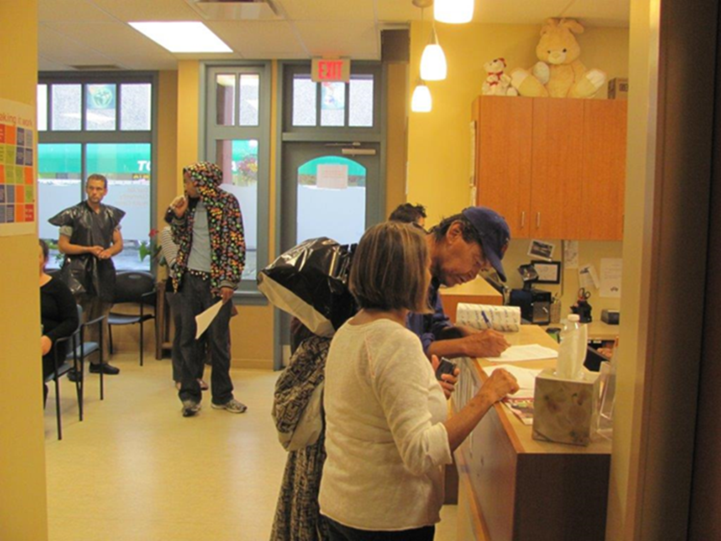
Solution #3. Ensure What Counts Gets Measured
New Measure of Equity-Oriented Care
New Equity-Sensitive Indicators
Notes:
To take context into account in the process of implementing equity-oriented interventions, we need to ensure we are measuring relevant processes, and feeding data back to the clinics, to support the process of tailoring care for equity.
For example, we used validated scales to assess the extent to which symptoms of trauma, and chronic pain were prevalent in these clinics’ patient populations.
Tailoring to Context included data feedback loops that compared the health status of the patient-populations-served to Local regional and population norms – which was essential to the organizations in terms of prioritizing the tailoring activities that each clinic decided to focus on.
We have also developed:
- a new, validated self-report measure of pt perceptions of EOC, and
new Indicators that are sensitive to the equity-orientation of organizations, to complement the CIHI Indicators for Primary care.
My own notes re Indicators:
Little work has been done on measuring attributes of high quality primary care—especially in the area of equity
Conventional approach to measuring the notion of equity has been via data disaggregation across socio-demographic groups
E.g. is there a gap in rates of screening between Aboriginal and non-Aboriginal Canadians, or a gradient by income?
Our purpose in EQUIP is to move beyond data disaggregation to :
- Identify some indicators that directly measure:
processes of care that are equity-oriented
short-term patient outcomes that are equity-sensitive
- Put these forward for use at clinic, regional, national levels.

Slide 11
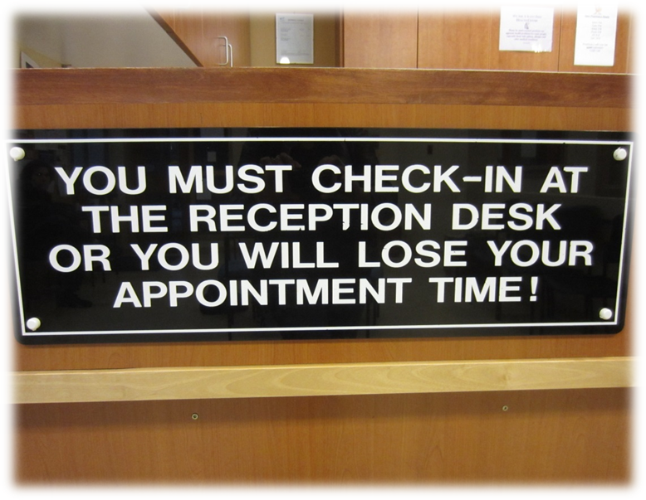
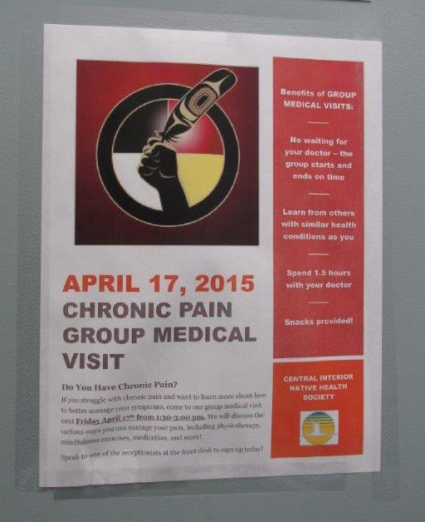


Solution #4. Low Cost-High and High Impact Strategies are Possible
Notes:
One of the key messages arising from EQUIP is that
Tailoring to context does not require large investments of resources.
The EQUIP intervention catalyzed changes that may seem small in scale but that represented broader efforts to enhance health equity, given the clinics’ unique contexts, for example:
Changing the waiting room milieu to make physical spaces more inviting, which is imperative for particular patient-populations who are very often dismissed when seeking care – for example, by taking down signs such as the one in the middle
Or by developing new ways of addressing chronic pain as one of the most common presenting issues in primary care settings.
Or by putting support in place to address vicarious trauma experienced by staff when working with highly traumatized refugee populations

Slide 12
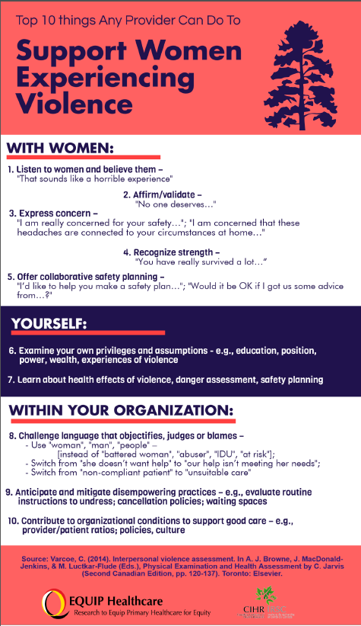
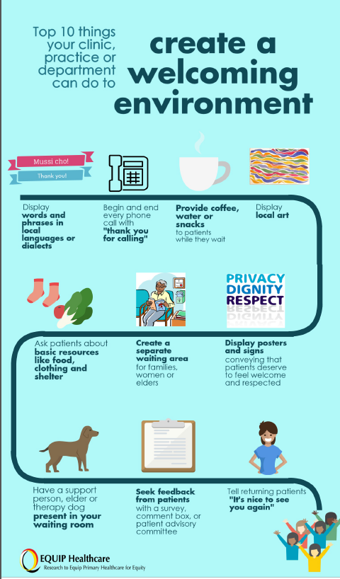
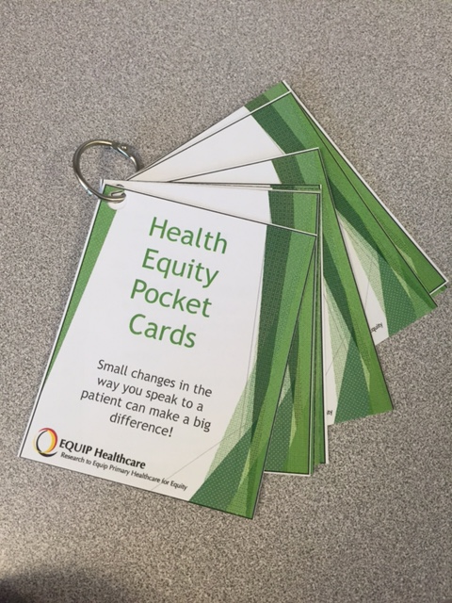
Tools: Theory -> Evidence -> Organizational Practices
Notes:
These are Examples of Practice-Relevant Tools and Strategies that we have developed, and which are garnering attention in terms of relevance and fit within several healthcare jurisdictions.
In conclusion, shifts in practices and processes to can be tailored to context to enhance the equity-capacity of organizations, and can be implemented using low-cost, high impact strategies.
Initial modelling of our Patient Cohort data show promise for linking equity-oriented care to improvements in short term outcomes, for example,
Improved overall fit of care with needs, and
Improved capacity to address health priorities
And we are continuing to explore impacts on longer term outcomes related to mental health (pain/disability, depression, PTSD), and quality of life
We look forward to talking with you about these and other strategies for transforming health services and systems to better address equity, including how to integrate context into intervention design, delivery, evaluation and scale-up.

